Slide 1

Vel Tech Rangarajan Dr. Sagunthala R&D Institute of Science and Technology
School of Computing
Department of Computer Science and Engineering
10211CS224 / FULL STACK APPLICATION DEVELOPMENT (JAVA)
PROJECT REVIEW : MILESTONE PROJECT – 2
Date: 20-04-2026
Job Portal Management System
SDG 9 – Industry, Innovation and Infrastructure
Presented By:
SHAIK SANHEERA
VTU26379 –23UECS1205
Courses Handling Faculty:
Mr. S. Manohar ME.,(Phd)
Assistant Professor

Slide 2
INTRODUCTION
1
The proposed Job Portal Management System is a comprehensive web-based platform designed to bridge the gap between job seekers and prospective employers. It serves as a centralized hub where students or professionals can discover opportunities and companies can efficiently source top talent. Built with a modern, responsive user interface, the system provides a seamless experience for browsing job listings, submitting resumes, and managing applications. It features secure role-based access control, ensuring that students, employers, and administrators have dedicated dashboards tailored to their specific needs. Ultimately, the portal streamlines the entire recruitment lifecycle, transforming a traditionally tedious process into an organized, digital workflow.
2
3
4
5
6
7
8

Slide 3
PROBLEM STATEMENT
1
In the current competitive job market, candidates often struggle to find relevant openings scattered across multiple unorganized platforms, leading to missed opportunities. Simultaneously, employers face significant challenges in managing high volumes of applications manually, often relying on fragmented email threads and physical resumes. Traditional recruitment processes lack a centralized tracking system, making it difficult to shortlist candidates efficiently or provide timely feedback. Furthermore, many existing solutions lack dedicated, intuitive workflows tailored specifically for student placement. There is a critical need for an integrated, automated platform that simplifies job discovery for applicants while providing robust applicant tracking tools for employers.
2
3
4
5
6
7
8
9

Slide 4
OBJECTIVE(S)
1
Centralized Connection: To develop a user-friendly platform that seamlessly connects job seekers with employers, streamlining the process of job posting, searching, and application submission.
Role-Based Management: To implement a secure architecture providing dedicated, feature-rich dashboards for Students, Employers, and Administrators to manage their respective activities.
Automated Tracking: To automate the applicant tracking process by enabling resume uploads, digital shortlisting, and real-time application status monitoring, thereby reducing manual overhead.
2
3
4
5
6
7
8
9

Slide 5
PROPOSED SYSTEM
1
The system follows a robust Client-Server architecture utilizing the Model-View-Controller (MVC) design pattern. The presentation layer is built using HTML5, Bootstrap, and Thymeleaf templates, providing a dynamic, responsive, and premium UI. The core business logic and request routing are handled by a Spring Boot backend, ensuring high performance and secure role-based access via Spring Security. Data persistence is managed through Spring Data JPA and Hibernate, mapping Java objects directly to a relational MySQL database. Additionally, the architecture incorporates a dedicated file management module to securely handle multipart resume uploads, making documents directly accessible to employers during the review phase.
2
3
4
5
6
7
8
9

Slide 6
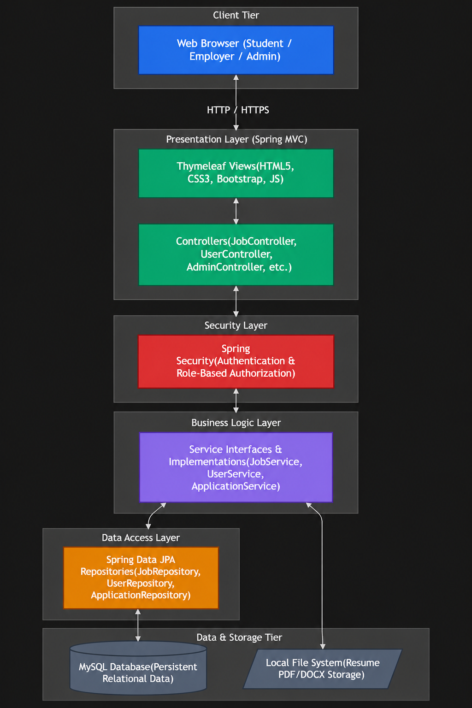
PROPOSED SYSTEM ARCHITECTURE
Block Diagram:
1
2
3
4
5
6
7
8
9

Slide 7
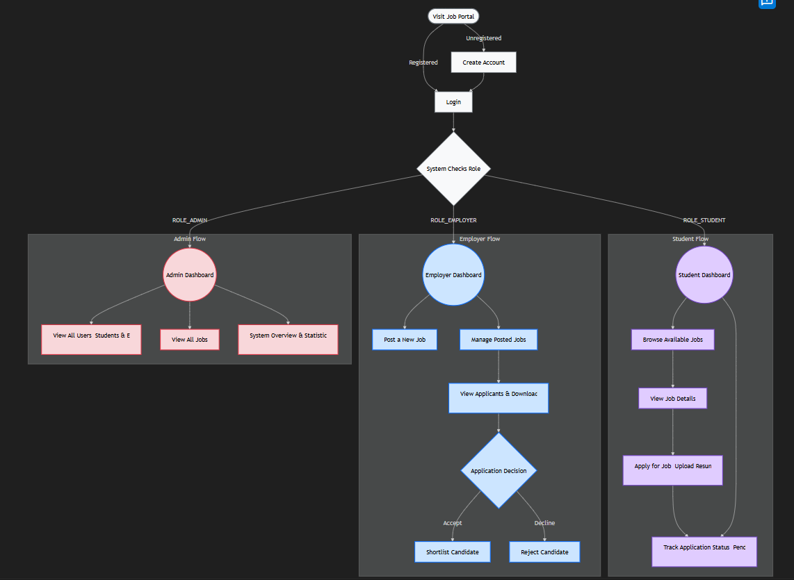
WORKFLOW
Data Flow Diagram:
1
2
3
4
5
6
7
8
9

Slide 8
TECHNOLOGIES USED
1
2
Frontend: HTML5, Custom CSS3 (Premium Dark Theme), Bootstrap 5, Thymeleaf, JavaScript
Backend: Java 17+, Spring Boot, Spring MVC, Spring Security
Database: MySQL, Spring Data JPA, Hibernate ORM
Tools & Architecture: Maven (Dependency Management), MVC Pattern, IDE (Eclipse/IntelliJ)
3
4
5
6
7
8
9

Slide 9
MODULE DESCRIPTION
Authentication & Authorization Module
Handles user registration, login, and session management using Spring Security. Ensures role-based access (Student, Employer, Admin) and redirects users to their dashboards.
2. Student / Job Seeker Module
Allows students to browse jobs, view details, upload resumes (PDF/DOCX), apply for jobs, and track application status (Pending, Shortlisted, Rejected)
3. Employer Recruitment Module
Enables employers to post jobs, manage listings, view applicants, download resumes, and shortlist or reject candidates.
4. Administrator Module
Provides system control for admins to monitor users, manage job postings, and view platform statistics (users, jobs, applications).
5. Application & File Management Module
Handles backend data storage, resume uploads/downloads, and manages relationships between Users, Jobs, and Applications using Spring Data JPA.
1
2
3
4
5
6
7
8
9

Slide 10
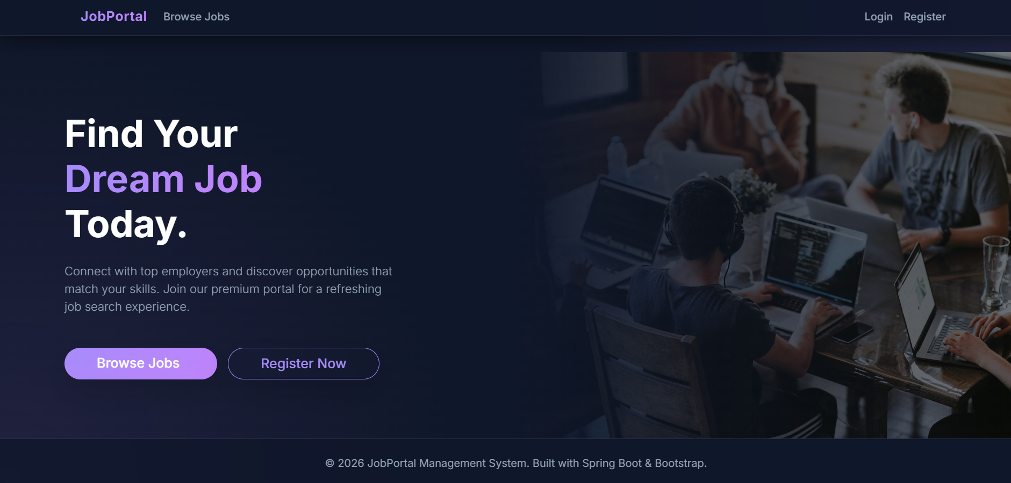
IMPLEMENTATION SCREENSHOTS
1
2
3
4
5
6
7
8
9
Simple Dashboard and home page for the Job Portal Management System where user can browse jobs and apply for them.

Slide 11
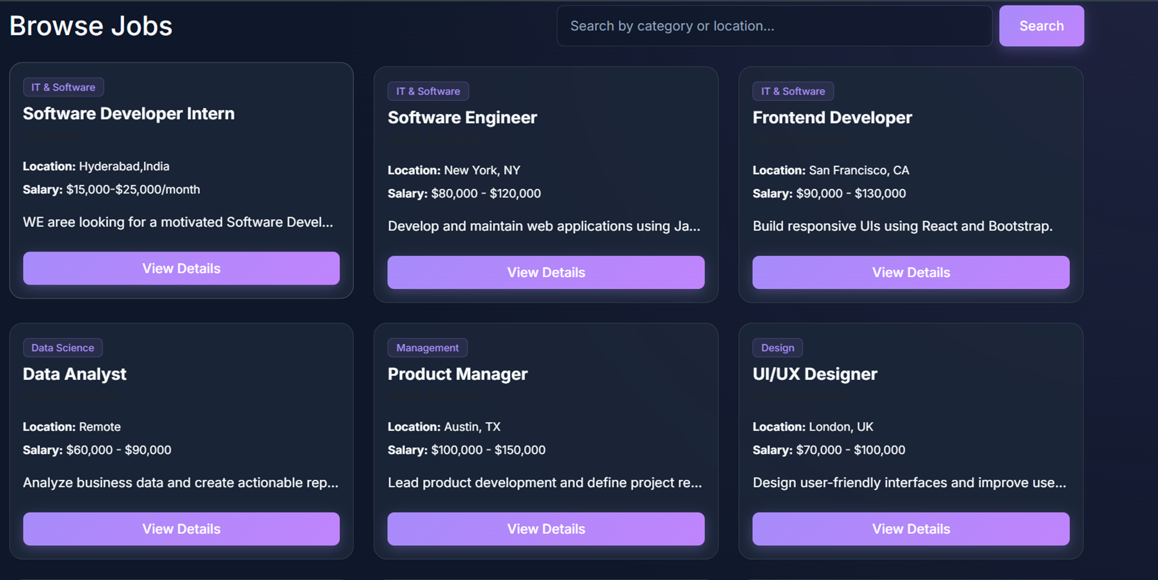
IMPLEMENTATION SCREENSHOTS
1
2
3
4
5
6
7
8(A)
9

Slide 12
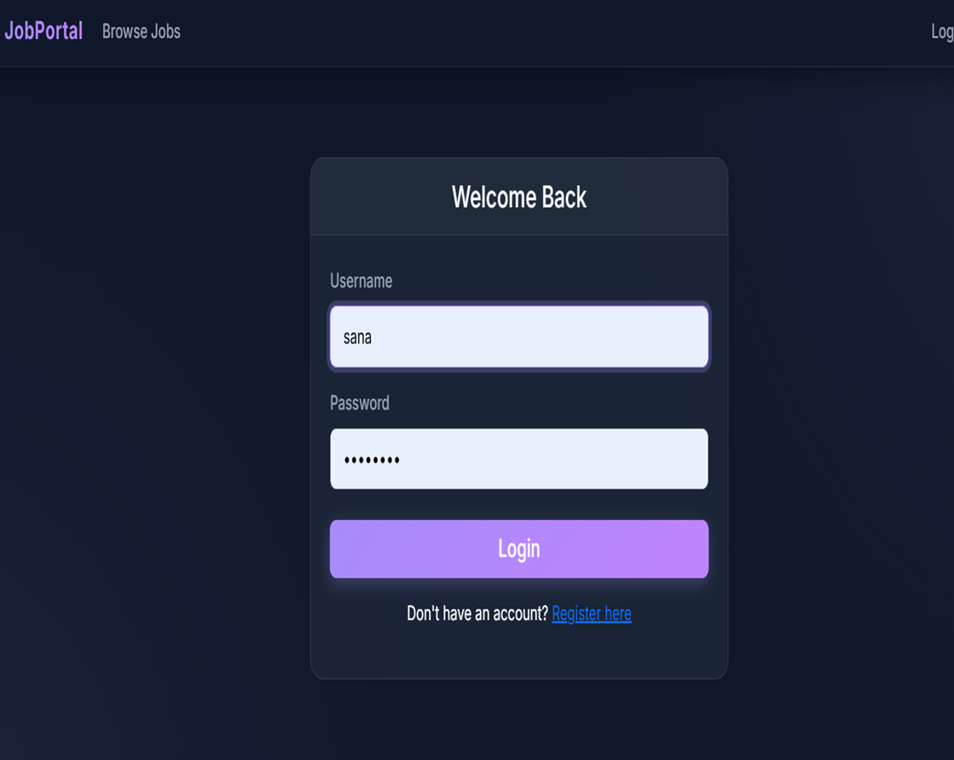
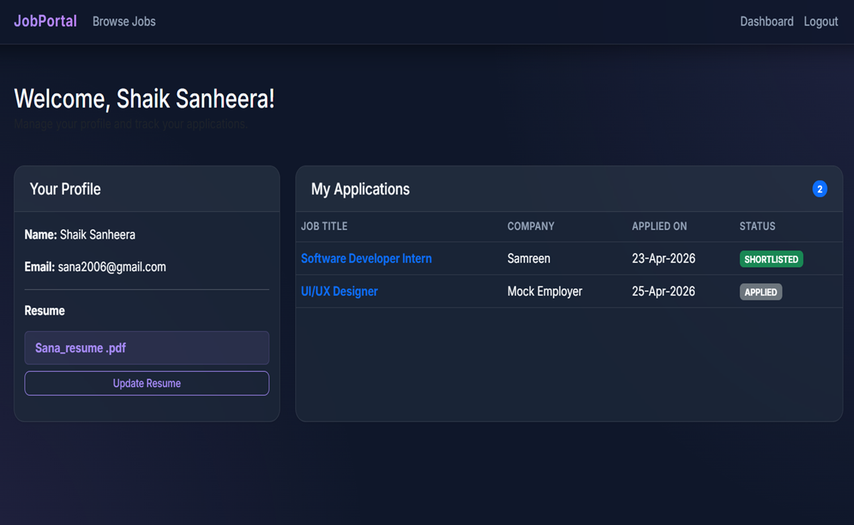
IMPLEMENTATION SCREENSHOTS
1
2
3
4
5
6
7
8(B)
9

Slide 13
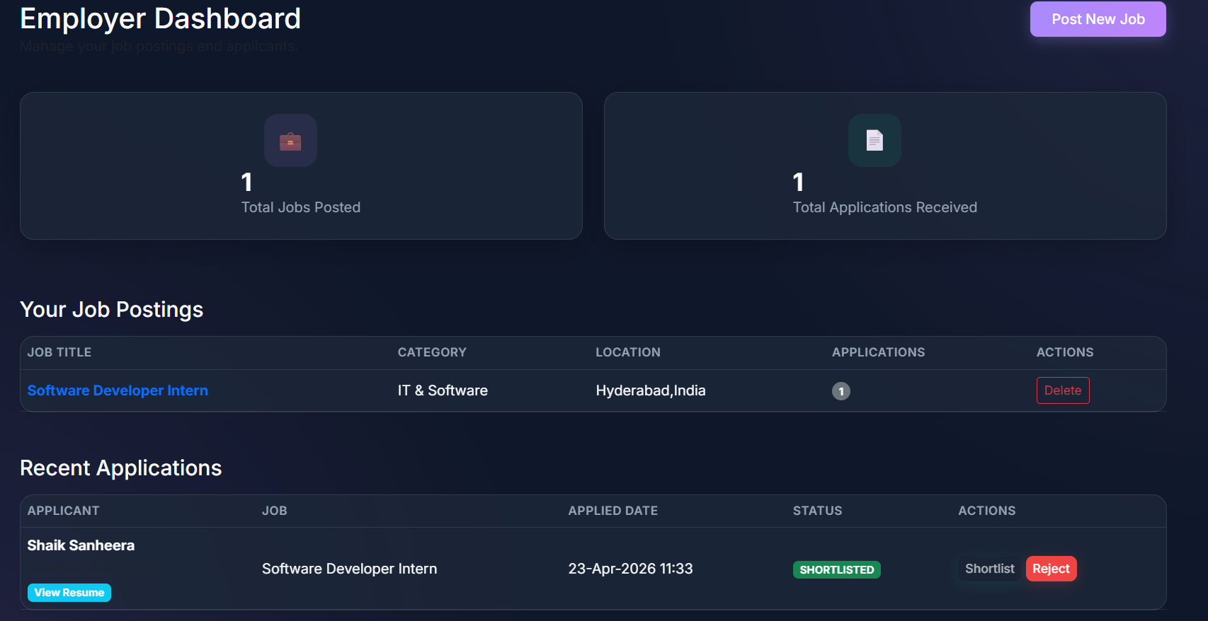
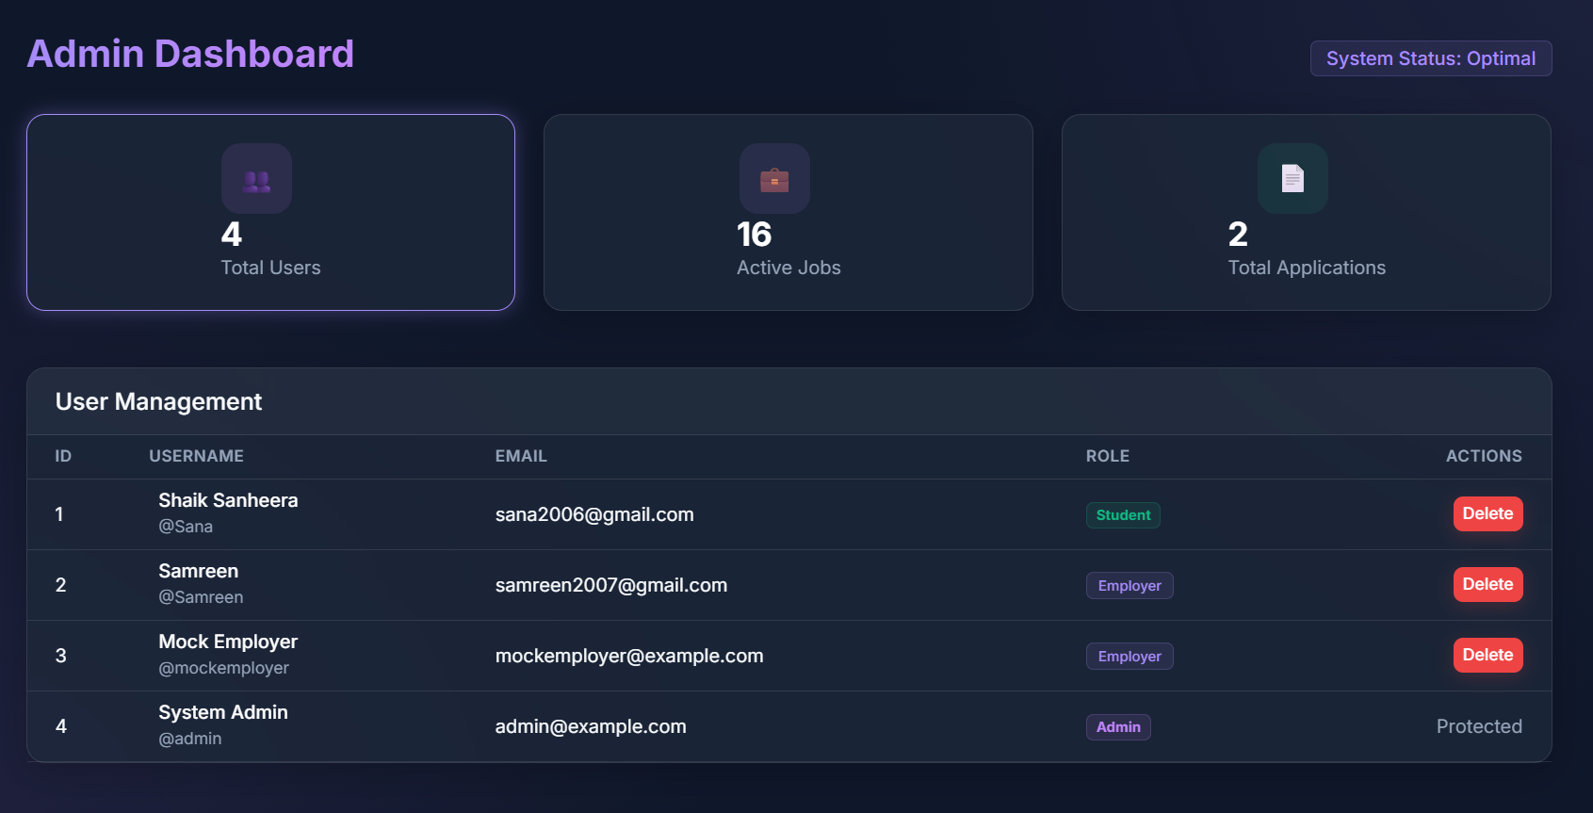
IMPLEMENTATION SCREENSHOTS
Employer dashboard where the employer can see the job applications of students and shortlist them. The employer can post the new jobs.
1
2
3
4
5
6
7
8(C)
Admin Dashboard where admin can keep track of all the data and manage the data of students and the employers.
9

Slide 14
ADVANTAGES & LIMITATIONS
1
Advantages
Enhanced Efficiency: Drastically reduces the time and manual effort required for both applying to jobs and sorting through candidate applications.
Centralized Data: Keeps all job listings, candidate resumes, and application statuses organized securely in one easily accessible database.
Scalability: The Spring Boot backend architecture allows the system to smoothly handle an increasing number of concurrent users and job postings.
Disadvantages
Internet Dependency: Requires a stable internet connection for users to browse jobs, upload documents, and review applications.
Storage Requirements: Handling thousands of multipart resume file uploads (PDFs/Docs) will eventually require scalable server storage solutions.
2
3
4
5
6
7
8
9

Slide 15
Thank you

